Slide 1
Introduction to Anaconda and conda

Slide 2
Anaconda is an open source distribution of Python and R for data science
includes:
more than 1500 packages
a graphical interface called Anaconda Navigator
a command line interface called Anaconda prompt
a tool called conda

Slide 3
conda is a tool to create and manage python environments
As you get into more advanced Python coding you will need to install different packages
When working with tools such as Jupyter notebooks, conda may be the simplest way to install libraries so they can be accessed from your notebooks

Slide 4

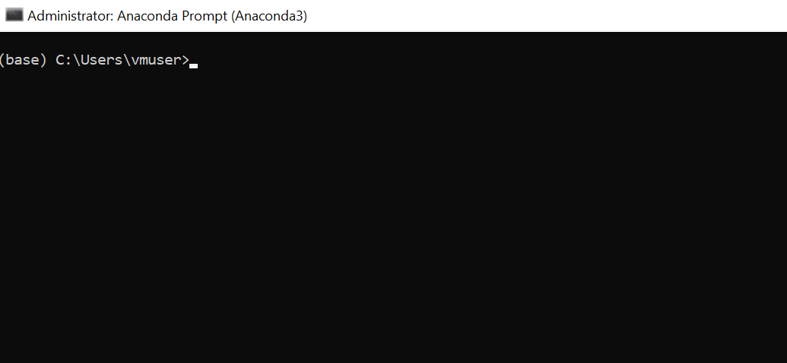
After you install Anaconda launch the prompt

Slide 5
Create a virtual environment with conda
conda create --name my_notebook_env python=3.7 –y
--name my_notebook_env the name of the environment
python=3.7 version of python in the environment
–y responds yes automatically to prompts

Slide 6
Activate your virtual environment
conda activate my_notebook_env
conda deactivate
will deactivate the current active environment
conda remove --name my_notebook_env --all
will permanently delete the virtual environment

Slide 7
Install library in the active environment
conda install pandas
Install jupyter
conda install jupyter
conda list
will return a list of installed libraries

Slide 8
Launch notebook from the active environment
1. Activate your environment
conda activate my_notebook_env
3. Launch Jupyter notebooks
jupyter notebook
NOTES:
<CTRL>+<C> <CTRL>+<C> will shut down the kernel and bring back the command prompt
You may need to deactivate and reactivate your environment before you launch Jupyter notebooks the first time after you install a new package

